Slide 1
Debating at Higher Levels

Slide 2
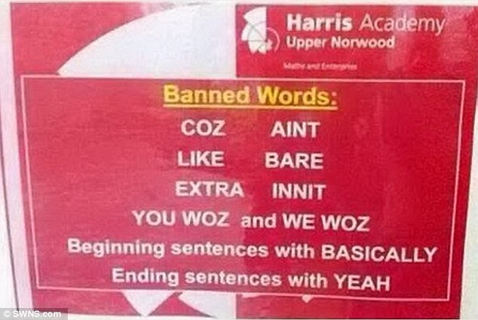
Guardian 5-minute debates
Should slang words be banned in the classroom?

Slide 3
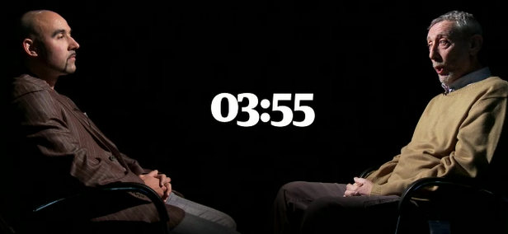
Should street slang be banned in the classroom?
Lindsay Johns vs Michael Rosen
Watch the video:
  Who wins and why?
  Chunks of language for high level students.
  Discourse management/structuring an argument.
  Video link

Slide 4
Structuring an Argument
Conceding/partially agreeing
Well, it’s very interesting and if you like, I agree with some of that from the point of view that we want young people to be empowered. But first of all, let’s go back on your notion of language is power; I’d say that’s pretty reductive. I think if you’re going to have a single sentence about what is power I would say money is power….
We have no evidence that simply speaking one kind of slang or one kind of local dialect actually prevents you from speaking another. We are all capable of being bi-dialectal, that’s to say speaking two kinds of language or more. So the key issue is why don’t your mates in Peckham choose to speak Standard English? Or maybe they can or maybe they know how to and choose not to so that’s one of the key issues.
Referring back & disputing
Being emphatic, steering the debate.
Presenting evidence (or lack thereof)

Slide 5
Structuring an Argument
Conceding/partially agreeing
Posing & answering questions
Michael:
“Ok so, let’s say I agree with the idea of the desirability of your friends learning Standard English. So the question is: how to get from the street slang that they speak to speaking or knowing how to speak in Standard English or Received Pronunciation or whatever you think is the most desirable. Now, as far as I understand it, you think you should ban it, now my view would be no, you study it.”
Hedging/being more indirect

Slide 6
Debate Structure
Opening statement (2 mins)
Cross examination (1 min)
(repeat)
Rebuttal #1 (1 min each)
Rebuttal #2 (1 min each)
Closing Statements (1 min each)

